Slide 1
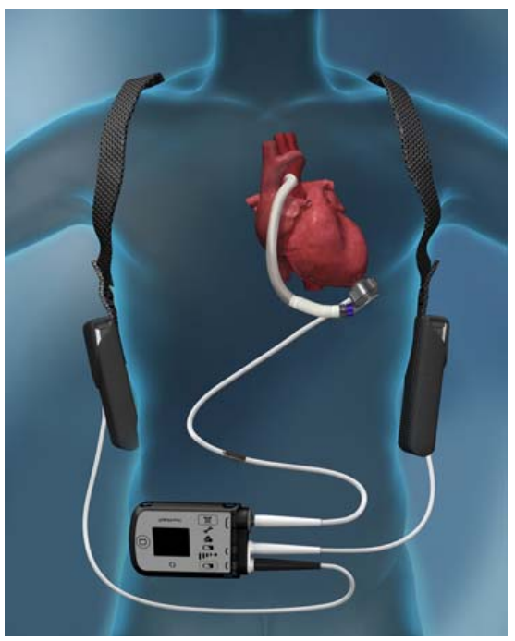

Warsaw University of Technology
Faculty of Mechatronics
Bachelor’s Diploma Thesis
CFD Analysis of a Ventricular Assist Device
in the field of Mechatronics
Written by Harshit Verma
Supervised by dr inż. Adam Piechna

Slide 2
Introduction

Slide 3
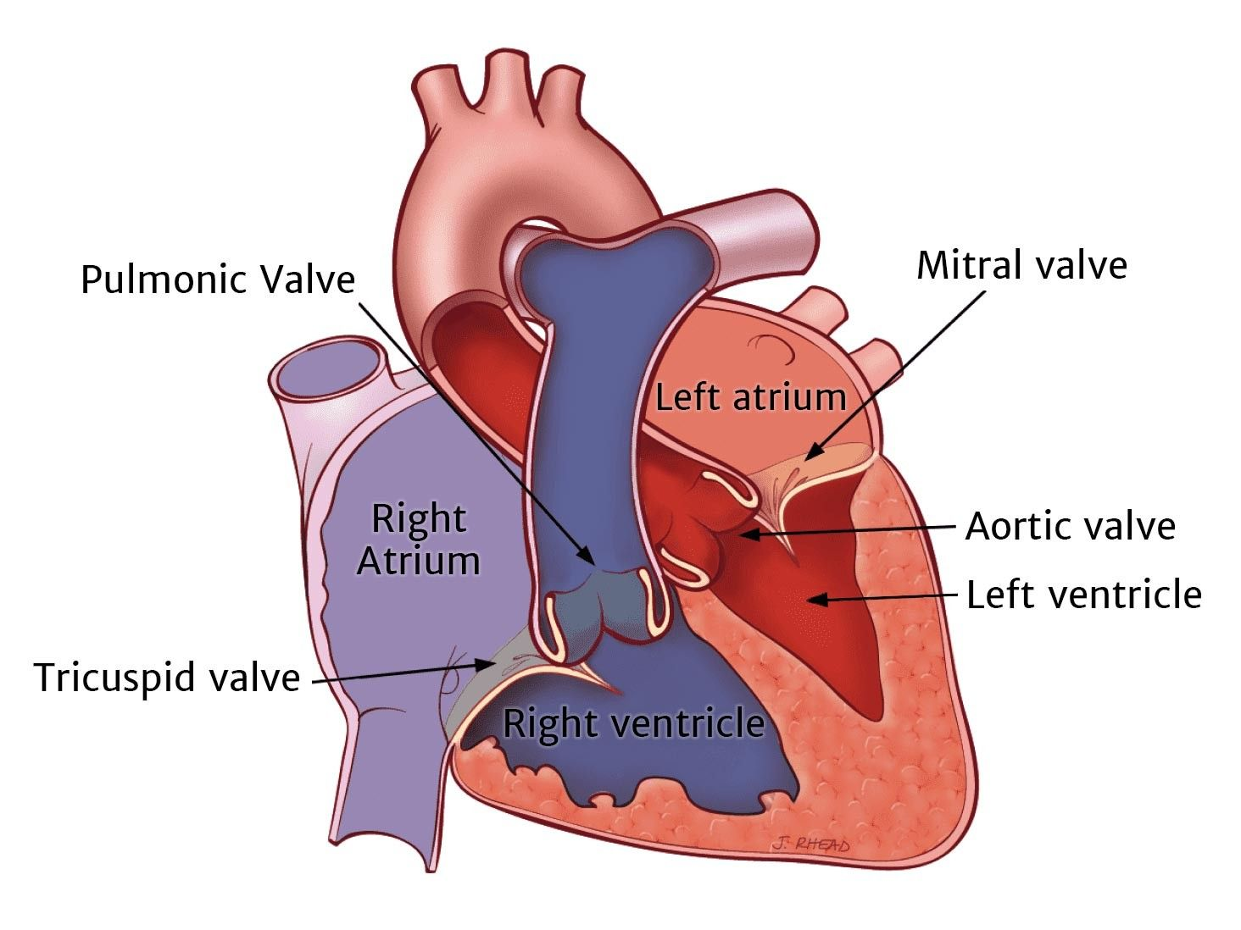
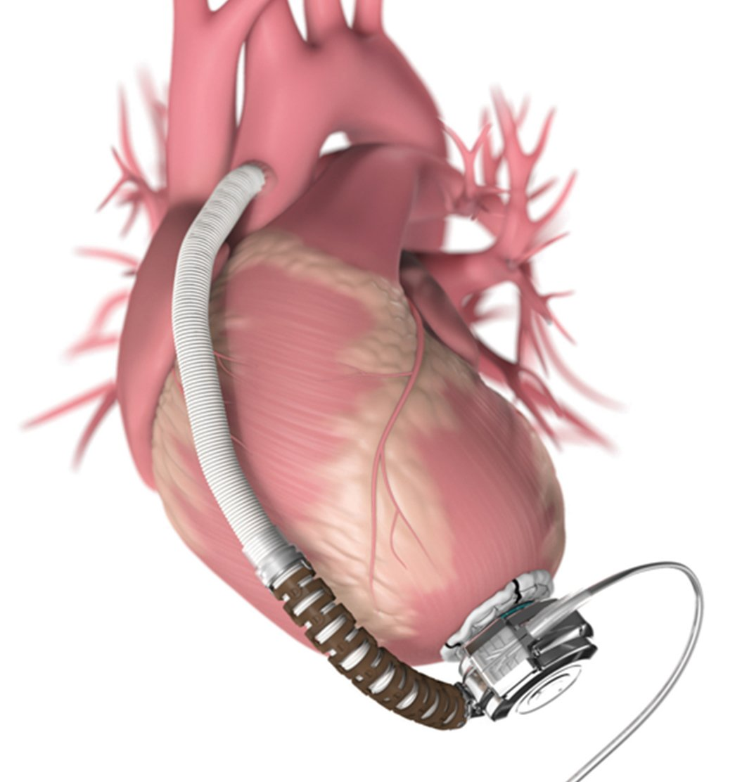
Background
Blood Flow Pathway:
Deoxygenated Blood: Body → RA → RV → Lungs
Oxygenated Blood: Lungs → LA → LV → Body
Heart Failure is a Growing Crisis
26 million globally (WHO)
Rising prevalence of cardiovascular diseases and heart failure globally.
Heart Patients need continous physical support.
Limited heart donors for transplant.

Slide 4
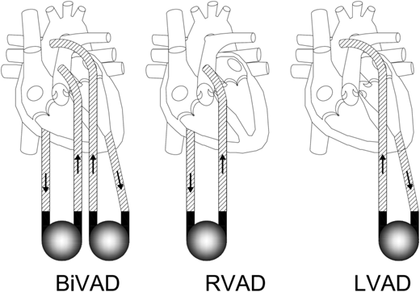
VADs
Ventricular Assist Devices (VADs)
VADs are pumps that help in pumping blood from weaker areas/ventricles of the heart.
Types of VADs based off on Flow: Pulsatile, Axial-Flow and Centrifugal-Flow pumps.
Types of VADs based of on Support System: Bi-VADs, RVADs and LVADs.
Doost, S.N., Zhong, L., & Morsi, Y.S. (2017). Ventricular assist devices: current state and challenges. Journal of Medical Devices, 11(4), 040801.

Slide 5
Types of VADs
VADs based of on flow type
Pulsatile Pumps: Mimic pulsatile nature of the heart. Creates Vortices that wash up the pump chamber.
Rotary Pumps: Continous flowing rotors allowing to push the blood.
Axial-Flow: Push blood parrallel to the pumps axis. Tubular flow design and faster rotational speed.
Centrifugal: Use centrifugal force to direct blood towards the blade’s edges.
Types of Blood Pumps for VADs
Pulsatile Pumps
Rotary Pumps
Centrifugal Pumps
Axial Flow Pumps

Slide 6
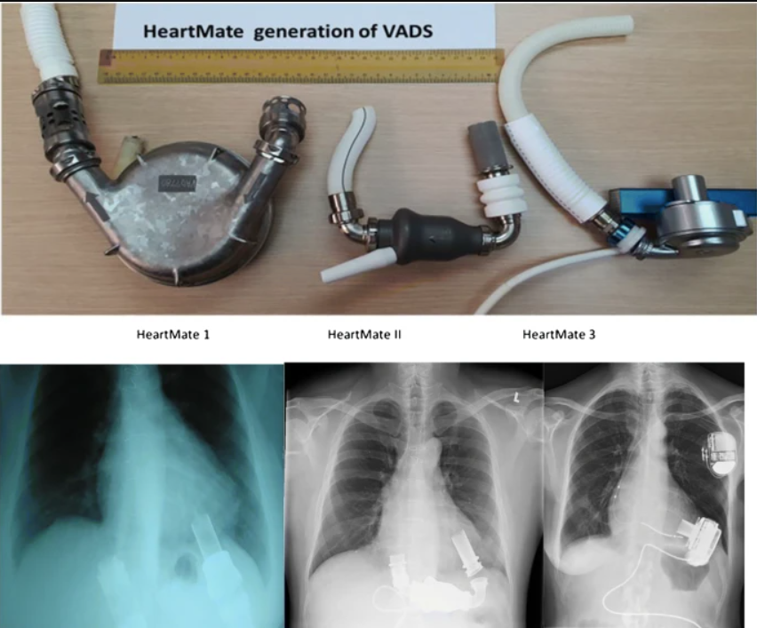
HeartMate3
HeartMate 1 (Pulsatile) vs. HeartMate 2 (Axial) vs. HeartMate 3 (Centrifugal)
HeartMate 3 is a VAD based on Centrifugal Pump Design.
HeartMate 3 has a maglev impeller, intrinsic pulse, low thrombosis risk.
Working range between 3000 – 9000 RPMs.
Timms, D. (2011). A review of clinical ventricular assist devices. Medical Engineering & Physics, 33(9), 1041-1047.

Slide 7
Problem Statement
HeartMate 3 geometry is proprietary; independent research needs approximate models.
Complex internal fluid dynamics lead to complications (high shear, turbulence, recirculation).
Need to optimize VADs for size, efficiency, and reduced blood damage while maintaining physiological flow.
IHeartmate 3TM Left Ventricular Assist Device, www.cardiovascular.abbott/content/dam/cv/cardiovascular/hcp/education-training/heart-failure/documents/hf-heartmate3-lvad-pump-parameters.pdf. Accessed 1 June 2025

Slide 8
Research Objective
To create a hydraulically representative CFD model inspired by HeartMate 3.
To validate model fidelity by comparing with published HeartMate 3 data.
To compare different turbulence models (SST k-ω, RNG k-ε).
To compare the base model with a modified blade design model.

Slide 9
Methodology

Slide 10
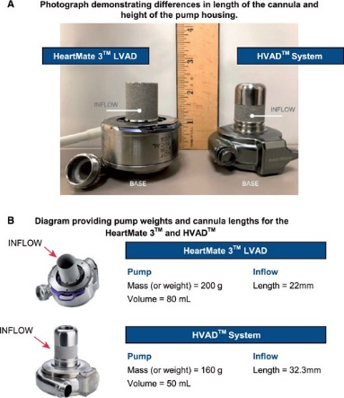
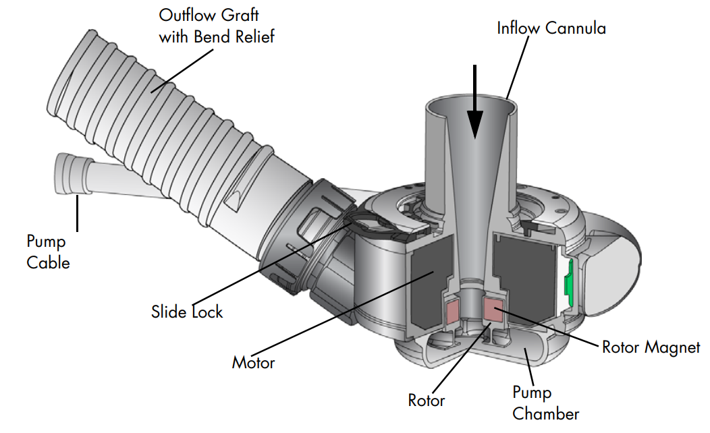
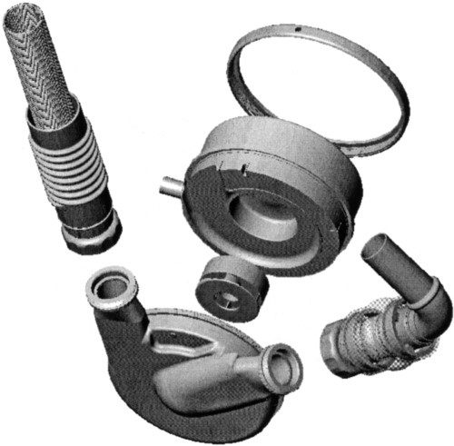
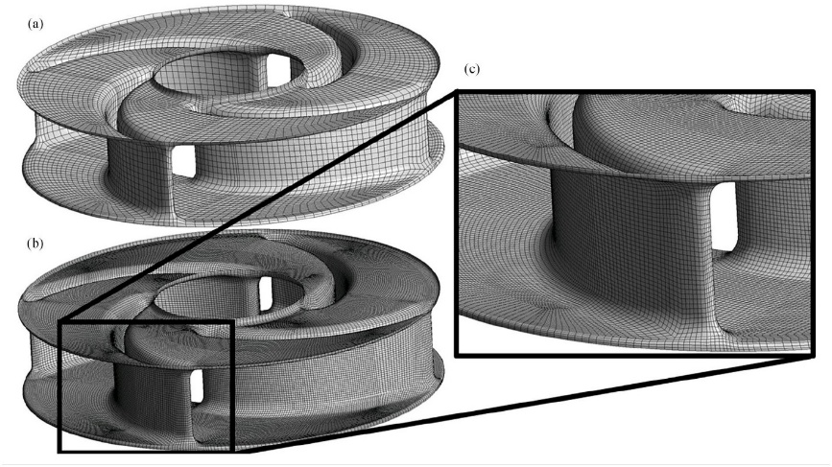
Geometry Creation (Base Model)
Exact Replica difficult to create due to proprietary design.
Online tools and resources used to measure the lentgh from imagees using parralax method
Maher, T.R., Butler, K.C., Poirier, V.L., & Gernes, D.B. (2001). HeartMate left ventricular assist devices: A multigeneration of implanted blood pumps. Artificial Organs, 25(5), 422-426.
Crone, V., Knüppel, F., Hahne, M., et al. (2024). Dynamic VAD simulations: Performing accurate simulations of ventricular assist devices in interaction with the cardiovascular system. The International Journal of Artificial Organs, 47(8), 624-632.
Salerno, C.T., Hayward, C., Hall, S., Goldstein, D., Saeed, D., Schmitto, J., ... & Pagani, F.D. (2022). HVAD to HeartMate 3 left ventricular assist device exchange: best practices recommendations. European Journal of Cardio-Thoracic Surgery, 62(1), ezac169.
Thoratec Corporation. (2017). HEART MATE 3 LEFT VENTRICULAR ASSIST SYSTEM INSTRUCTIONS FOR USE.

Slide 11
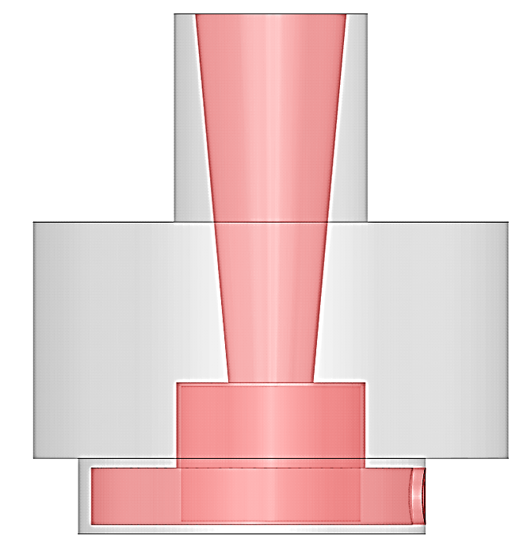
Geometry Creation (Base Model)
Simplified, hydraulically representative model (not exact replica due to proprietary nature).
Components: Housing (stator) and Rotor (impeller).
Volume extraction: Actual_Rotating_Volume and Actual_Static_Volume.

Slide 12
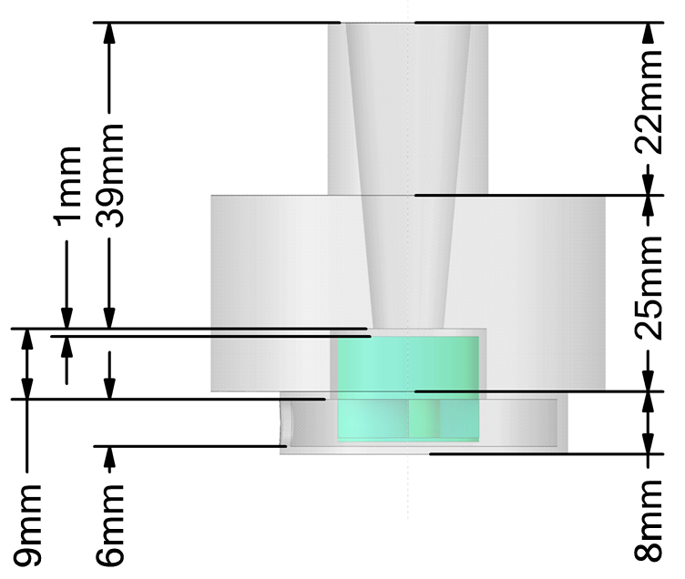
Geometry Creation (Base Model)
Many of the dimenions were measured using online tools based on the Parrallax method.
Some of the dimenions were assumed, like the clearance between the rotor and the casing to avoid hemolysis.

Slide 13
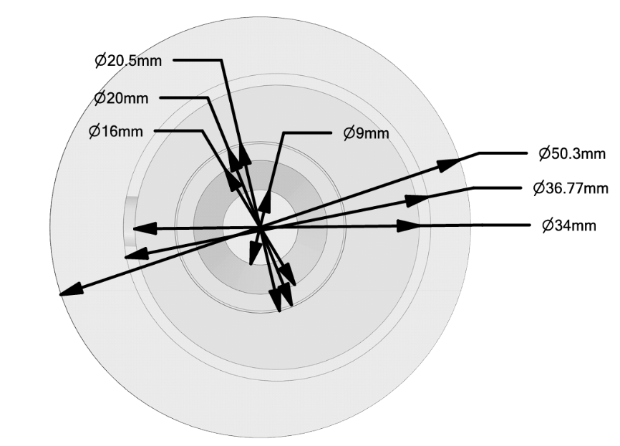
Geometry Creation (Base Model)
Many of the dimenions were measured using online tools based on the Parrallax method.
Some of the dimenions were assumed, like the clearance between the rotor and the casing to avoid hemolysis.

Slide 14
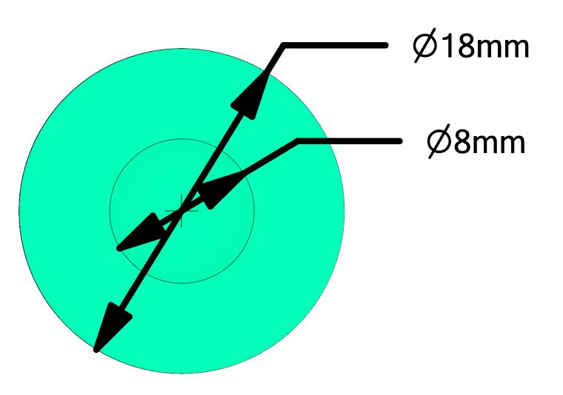
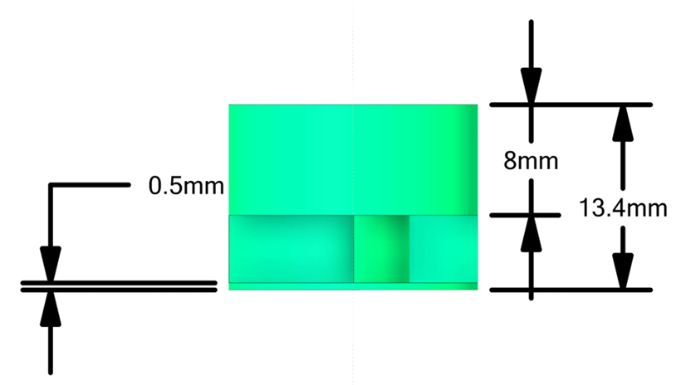
Geometry Creation (Base Model)
Many of the dimenions were measured using online tools based on the Parrallax method.
Some of the dimenions were assumed, like the clearance between the rotor and the casing to avoid hemolysis.

Slide 15
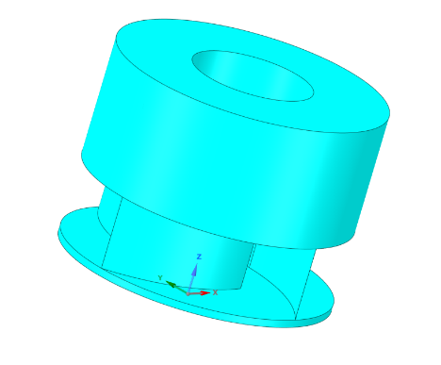
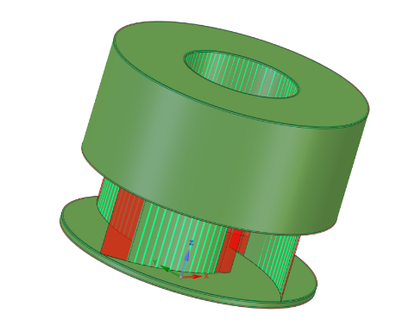
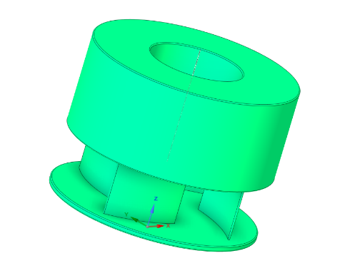
Red regions showing the removed edges of the rotor of the base model and the new model with smaller and smoother edges.
Base Model
Blade Modified Model
For Modified Blades model, Blades were reduced by 20% for the modified blade design.

Slide 16
Red regions showing the removed edges of the rotor of the base model and the new model with smaller and smoother edges.
Base Model
Blade Modified Model

Slide 17
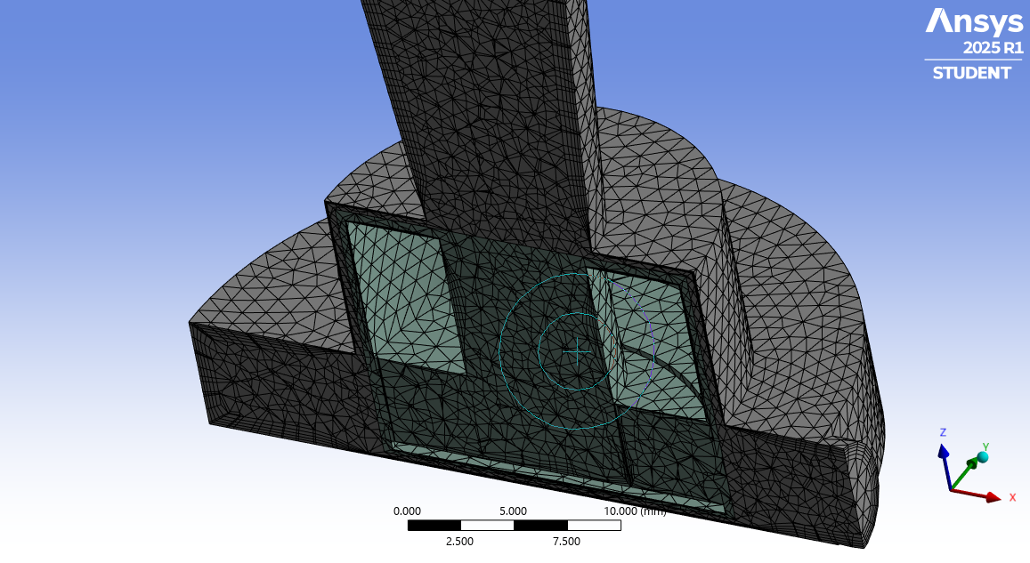
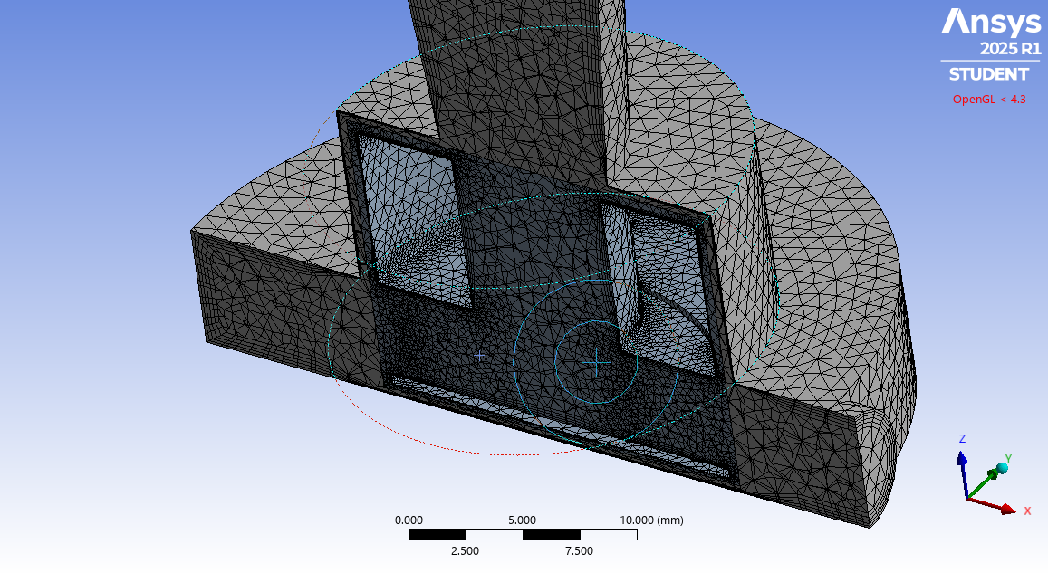
Meshing Strategy
Target: < 1 million elements (Student Version limit).
Quality criteria: Skewness < 0.95, Orthogonal Quality > 0.65.
On the Base Model, Mesh generated with a quality not up to the standards set.
Some discrepencies allowed.
Design change: Blades narrowed by 20%, sharp edges rounded.
Mesh upto the standard set.
Base Model
Blade Modified Model

Slide 18
Fluent Solver Setup
Fluid Properties
Blood treated as Newtonian fluid (initial assumption).
Density: 1025 kg/m³, Dynamic Viscosity: 0.0035 Pa·s.
SST k-ω (primary, robust for near-wall/separation).
RNG k-ε (comparative, suitable for swirling flows).
Boundary Conditions:
Inlet: Pressure Inlet (0 Pa gauge, simulating atrial pressure).
Outlet: Pressure Outlet (varied incrementally to generate pump curves).
Walls: No-slip boundary condition.
Monitors & Convergence:
Monitored: Torque, Mass Flow Rate, Static Pressure, Scaled Residuals.
Turbulence Model:
Multiple Reference Frame (MRF) method for rotor motion.
Angular velocities: 3000, 5000, 7000 RPM.
Hybrid initialization used, run until stabilization.

Slide 19
Results & Discussions

Slide 20
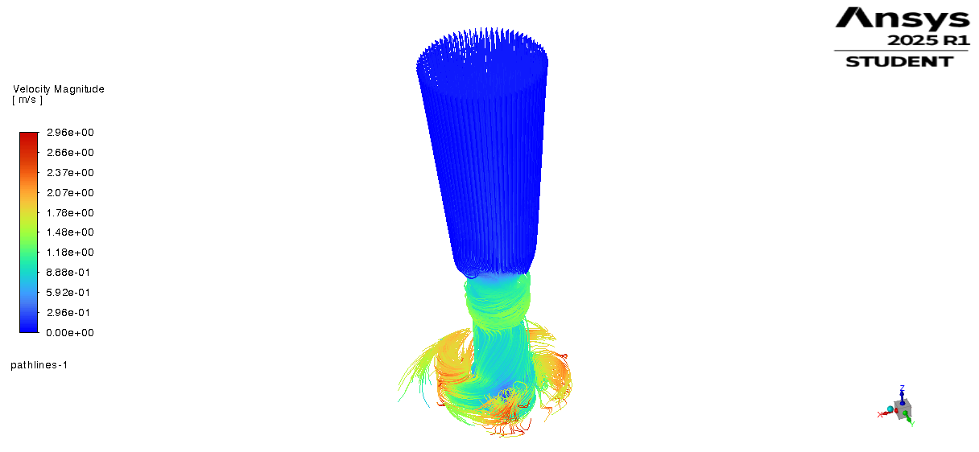
Base Model (SST k-omega) at 3000 RPM
Fluid enters axially from inlet and is guided to rotor center.
Impeller rotation generates centrifugal force, expelling fluid radially.
Flow converts kinetic energy into pressure along stator walls.
Pathlines validate efficient flow guidance and outlet delivery.
Flow patterns show fluid enveloping the rotor, supporting the magnetic levitation principle seen in HeartMate 3, reducing friction and wear.

Slide 21
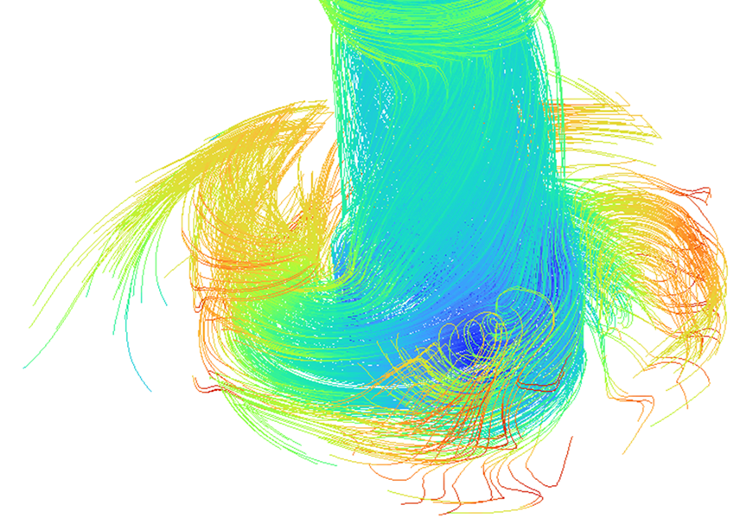
Base Model (SST k-omega) at 3000 RPM
Fluid enters axially from inlet and is guided to rotor center.
Impeller rotation generates centrifugal force, expelling fluid radially.
Flow converts kinetic energy into pressure along stator walls.
Pathlines validate efficient flow guidance and outlet delivery.
Flow patterns show fluid enveloping the rotor, supporting the magnetic levitation principle seen in HeartMate 3, reducing friction and wear.

Slide 22
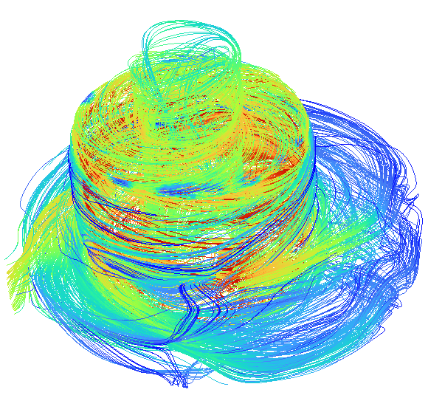
Base Model (SST k-omega) at 3000 RPM
Fluid enters axially from inlet and is guided to rotor center.
Impeller rotation generates centrifugal force, expelling fluid radially.
Flow converts kinetic energy into pressure along stator walls.
Pathlines validate efficient flow guidance and outlet delivery.
Flow patterns show fluid enveloping the rotor, supporting the magnetic levitation principle seen in HeartMate 3, reducing friction and wear.

Slide 23
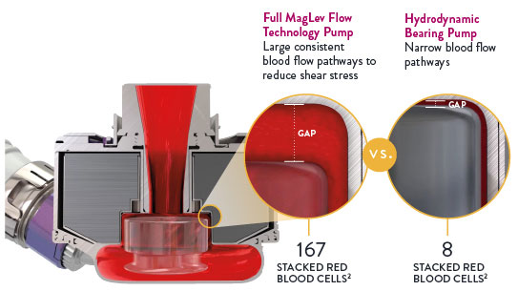
Base Model (SST k-omega) at 3000 RPM
Fluid enters axially from inlet and is guided to rotor center.
Impeller rotation generates centrifugal force, expelling fluid radially.
Flow converts kinetic energy into pressure along stator walls.
Pathlines validate efficient flow guidance and outlet delivery.
Flow patterns show fluid enveloping the rotor, supporting the magnetic levitation principle seen in HeartMate 3, reducing friction and wear.
Thoratec Corporation. (2017). HEART MATE 3 LEFT VENTRICULAR ASSIST SYSTEM INSTRUCTIONS FOR USE.

Slide 24
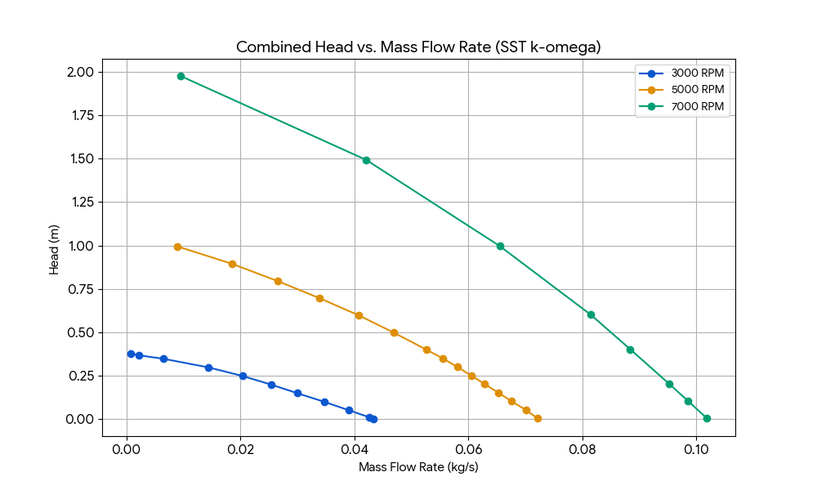
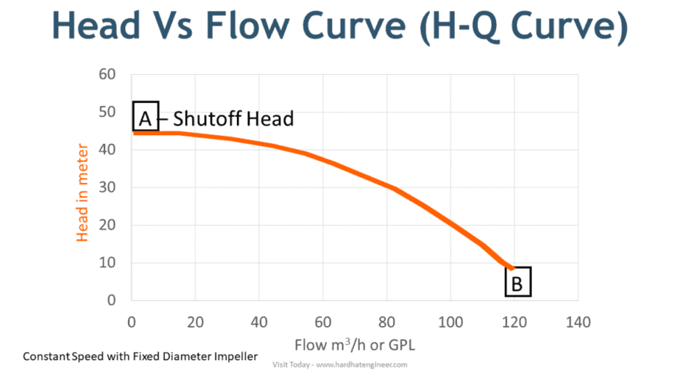
Base Model (SST k-omega) at different RPMs
Higher RPMs lead to greater head generation and flow capacity (curves shift upward and rightward).
The presure head keeps dropping with increased flow.
Model effectively captures typical centrifugal pump behavior and its scalability with speed.

Slide 25
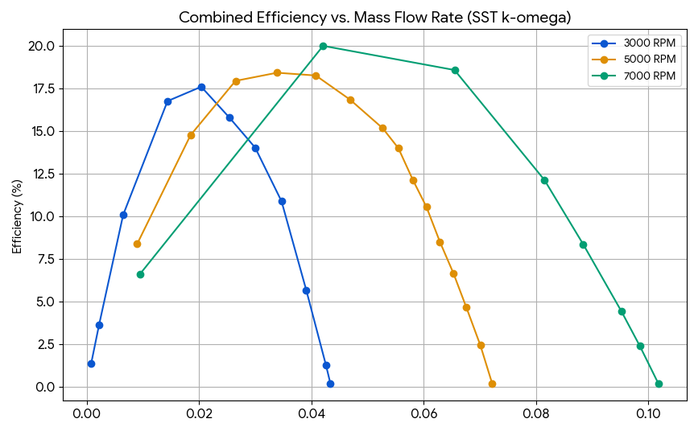
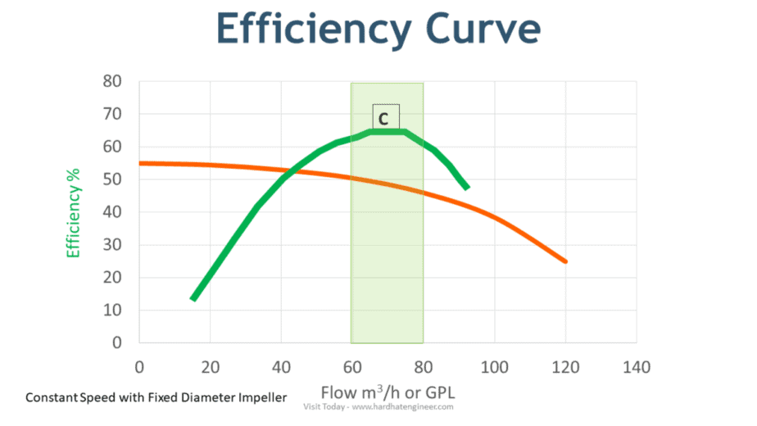
Base Model (SST k-omega) at different RPMs
BEP shifts to higher flow/head values with increasing RPM.
Higher RPMs generated higher efficiency peaks.

Slide 26
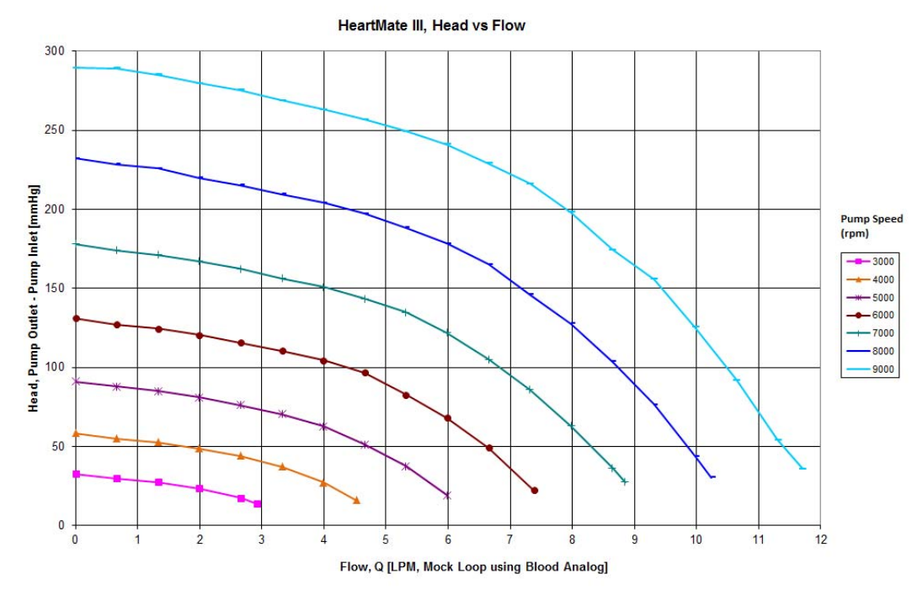
Base Model (SST k-omega) vs Abbott model
Thoratec Corporation. (2017). HEART MATE 3 LEFT VENTRICULAR ASSIST SYSTEM INSTRUCTIONS FOR USE.
H-Q graph generated by simulating the Base Model based on HeartMate 3.
H-Q graph given by Abott documentation for HeartMate 3.

Slide 27
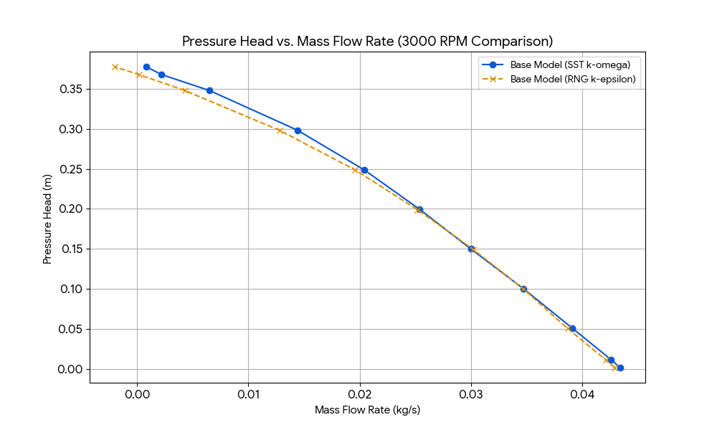
Base Model (SST k-omega) vs Base Model (RNG k-epsilon)
Both models show similar head-flow trends.
SST k-ω provides slightly higher peak efficiency and broader optimal range.

Slide 28
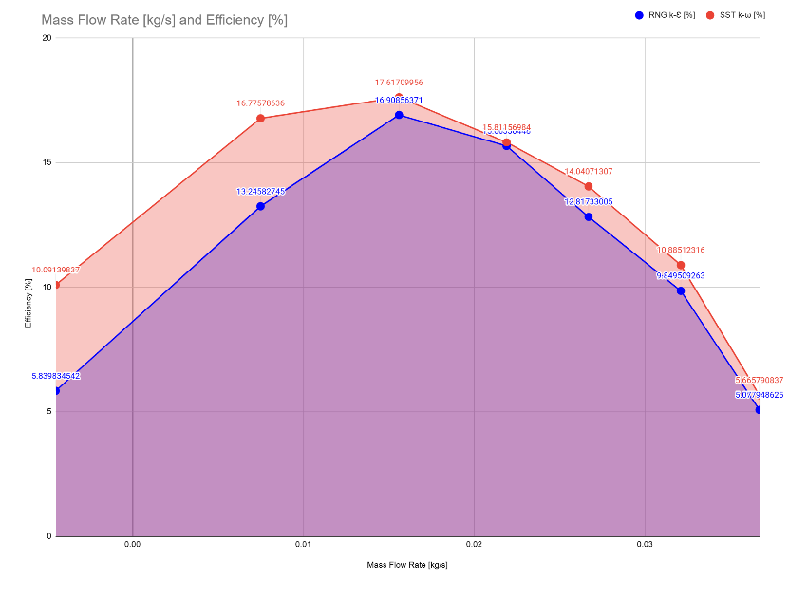
Base Model (SST k-omega) vs Base Model (RNG k-epsilon)
Both models show similar head-flow trends.
SST k-ω provides slightly higher peak efficiency and broader optimal range.

Slide 29
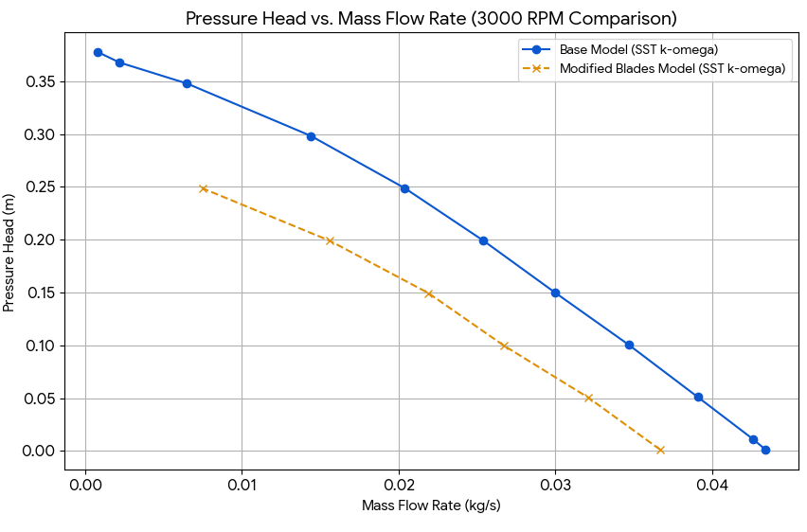
Base Model vs Modified Model (SST k-omega)
Modified blades have a narrower profile, rounded edges.
Slightly reduced pressure head.
Reduction in peak efficiency
Design trade-off between flow throughput and pressure generation.

Slide 30
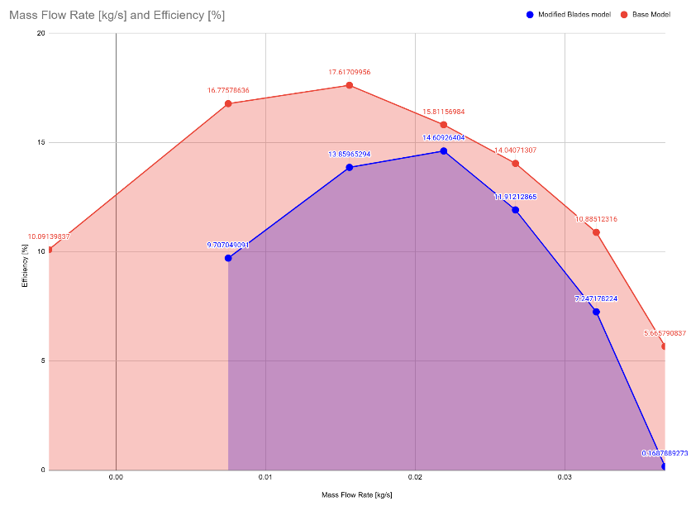
Base Model vs Modified Model (SST k-omega)
Modified blades have a narrower profile, rounded edges.
Slightly reduced pressure head.
Reduction in peak efficiency
Design trade-off between flow throughput and pressure generation.

Slide 31
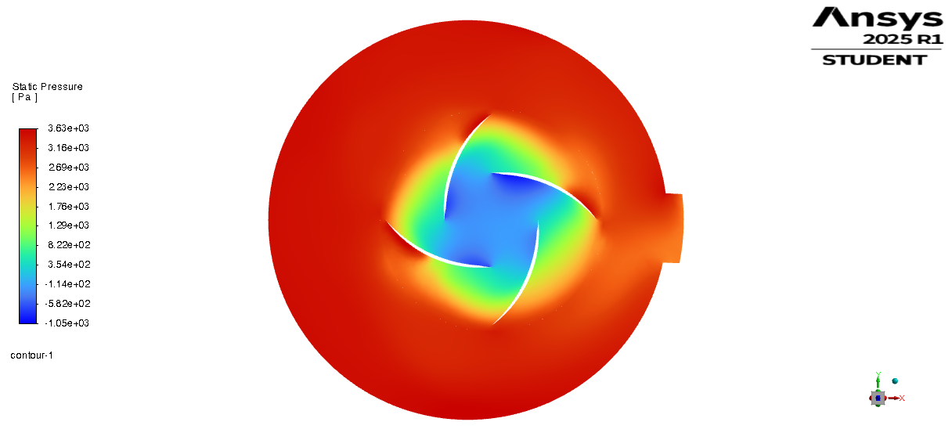
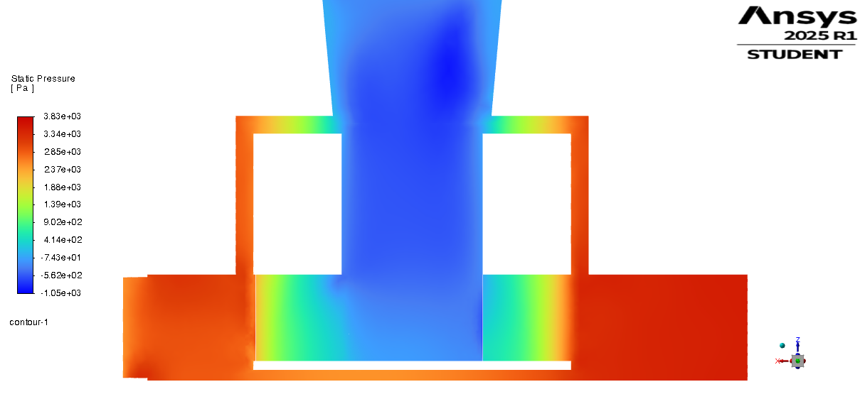
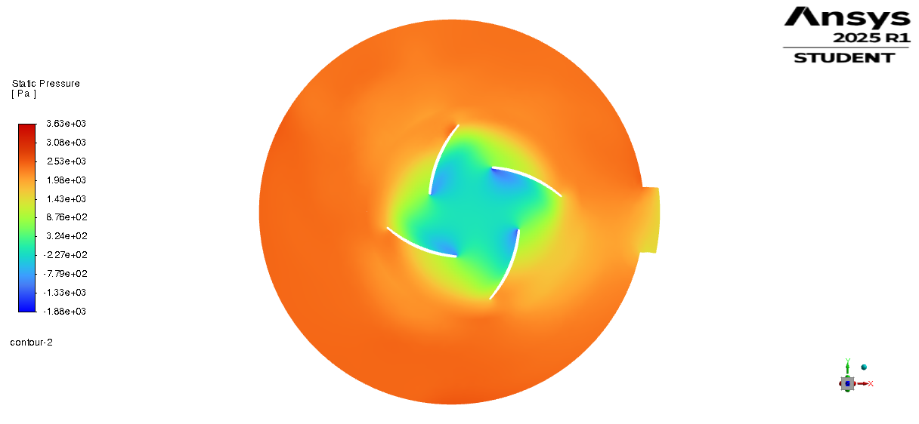
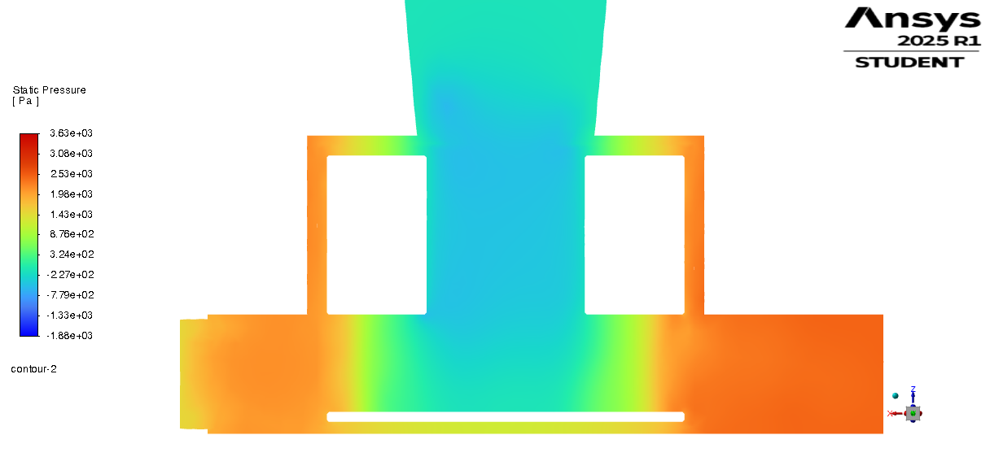
Base Model vs Modified Model (SST k-omega)
Base Model (SST k-ω at 3000 RPM)
Pressure Profile
Both models show pressure rise from inlet to outlet, typical of centrifugal pumps.
Modified blades yield a smoother pressure field around the impeller, suggesting more gradual acceleration of fluid.
Side views confirm pressure development is preserved across designs.
Blade Modified Model (SST k-ω at 3000 RPM)

Slide 32
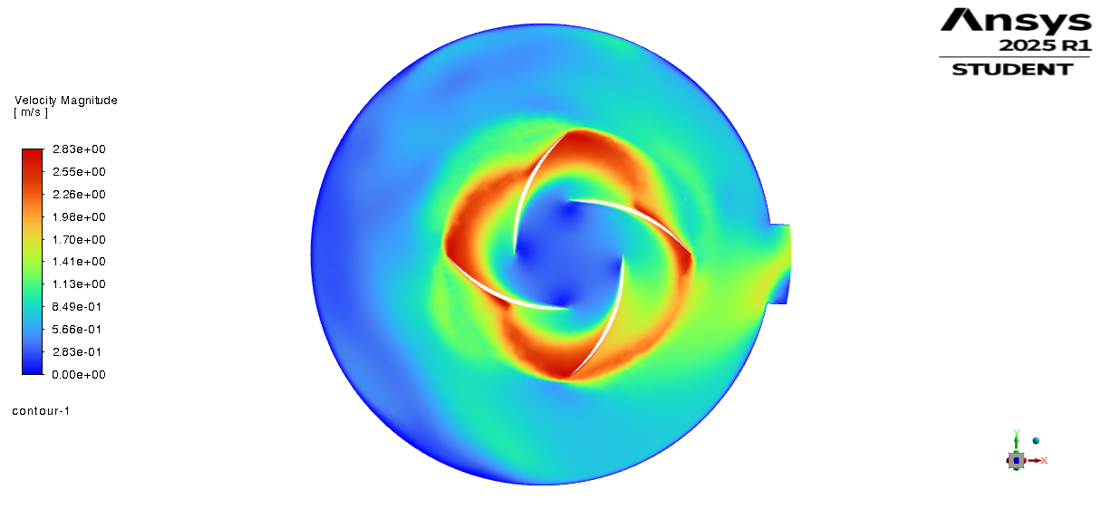
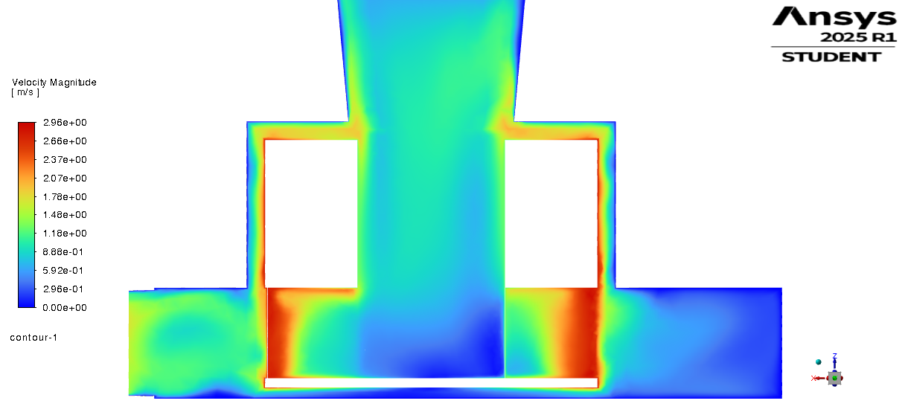
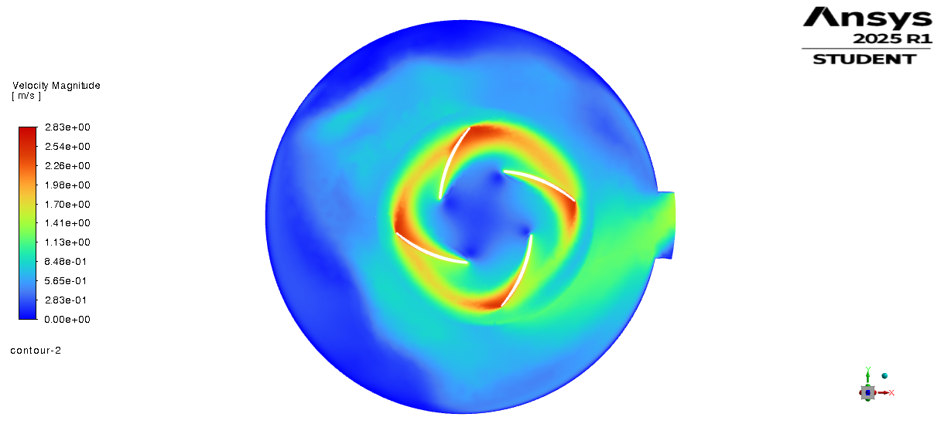
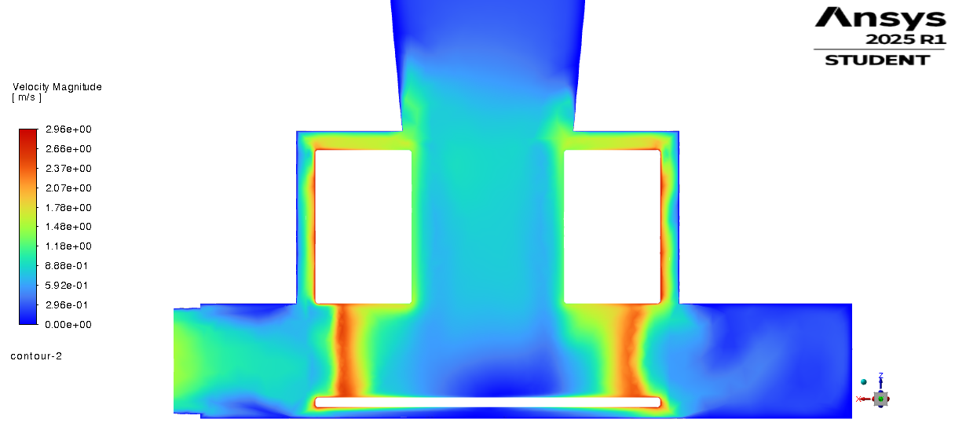
Base Model vs Modified Model (SST k-omega)
Base Model (SST k-ω at 3000 RPM)
Velocity Profile
High velocities occur at blade tips, driving flow outward.
Modified model shows better organized outflow downstream.
Axial-to-radial transition preserved in both cases
Blade Modified Model (SST k-ω at 3000 RPM)

Slide 33
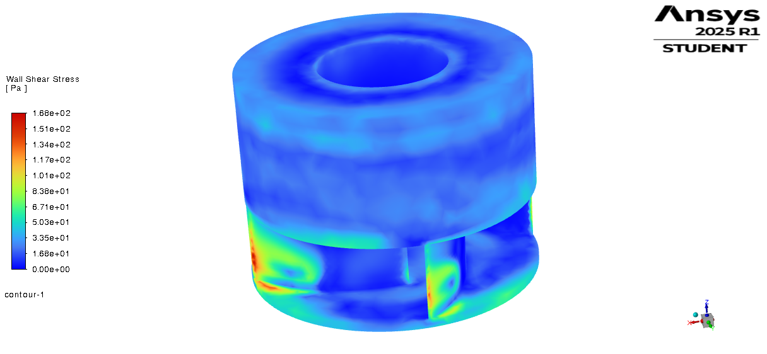
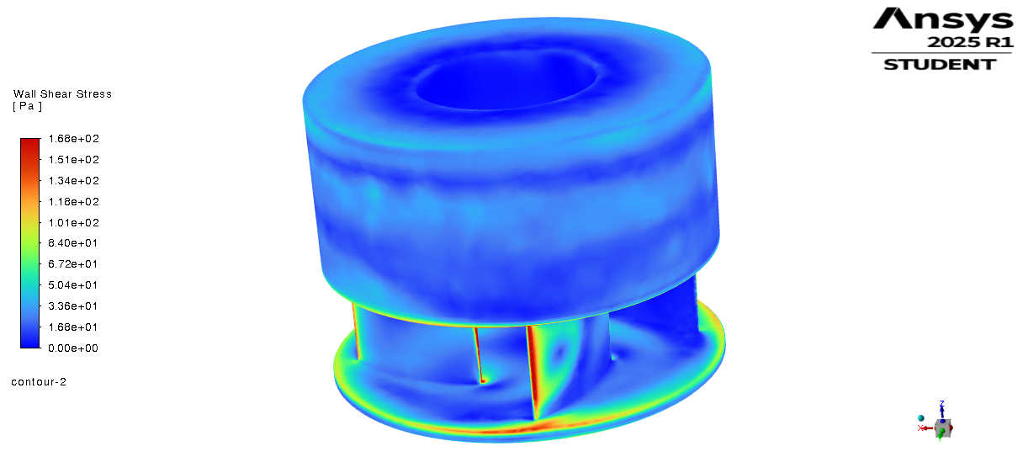
Base Model vs Modified Model (SST k-omega)
Base Model (SST k-ω at 3000 RPM)
Wall Shear Stress Profile
Base model shows high WSS near sharp blade edges.
Modified blades distribute WSS more evenly.
Higher Wall Shear Stress found near some the rounded edges of Modified model.
New areas introduced with High Shear Stress.
Blade Modified Model (SST k-ω at 3000 RPM)

Slide 34
Conclusions
Successfully developed and validated a CFD model representing HeartMate 3 performance.
Captured key hydraulic behaviors (head, flow, efficiency, power) across various RPMs and designs.
SST k-ω found most suitable turbulence model for this study.
Blade modification showed trade-offs, highlighting optimization potential.
Model provides a strong foundation for future, more detailed analyses.
Thoratec Corporation. (2017). HEART MATE 3 LEFT VENTRICULAR ASSIST SYSTEM INSTRUCTIONS FOR USE.

Slide 35
Conclusions
Successfully developed and validated a CFD model representing HeartMate 3 performance.
Captured key hydraulic behaviors (head, flow, efficiency, power) across various RPMs and designs.
SST k-ω found most suitable turbulence model for this study.
Blade modification showed trade-offs, highlighting optimization potential.
Model provides a strong foundation for future, more detailed analyses.
Thoratec Corporation. (2017). HEART MATE 3 LEFT VENTRICULAR ASSIST SYSTEM INSTRUCTIONS FOR USE.

Slide 36
Conclusions
Successfully developed and validated a CFD model representing HeartMate 3 performance.
Captured key hydraulic behaviors (head, flow, efficiency, power) across various RPMs and designs.
SST k-ω found most suitable turbulence model for this study.
Blade modification showed trade-offs, highlighting optimization potential.
Model provides a strong foundation for future, more detailed analyses.

Slide 37
Conclusions
Successfully developed and validated a CFD model representing HeartMate 3 performance.
Captured key hydraulic behaviors (head, flow, efficiency, power) across various RPMs and designs.
SST k-ω found most suitable turbulence model for this study.
Blade modification showed trade-offs, highlighting optimization potential.
Model provides a strong foundation for future, more detailed analyses.
Base Model (SST k-ω at 3000 RPM)
Blade Modified Model (SST k-ω at 3000 RPM)

Slide 38
Conclusions
Successfully developed and validated a CFD model representing HeartMate 3 performance.
Captured key hydraulic behaviors (head, flow, efficiency, power) across various RPMs and designs.
SST k-ω found most suitable turbulence model for this study.
Blade modification showed trade-offs, highlighting optimization potential.
Model provides a strong foundation for future, more detailed analyses.

